Slide 1
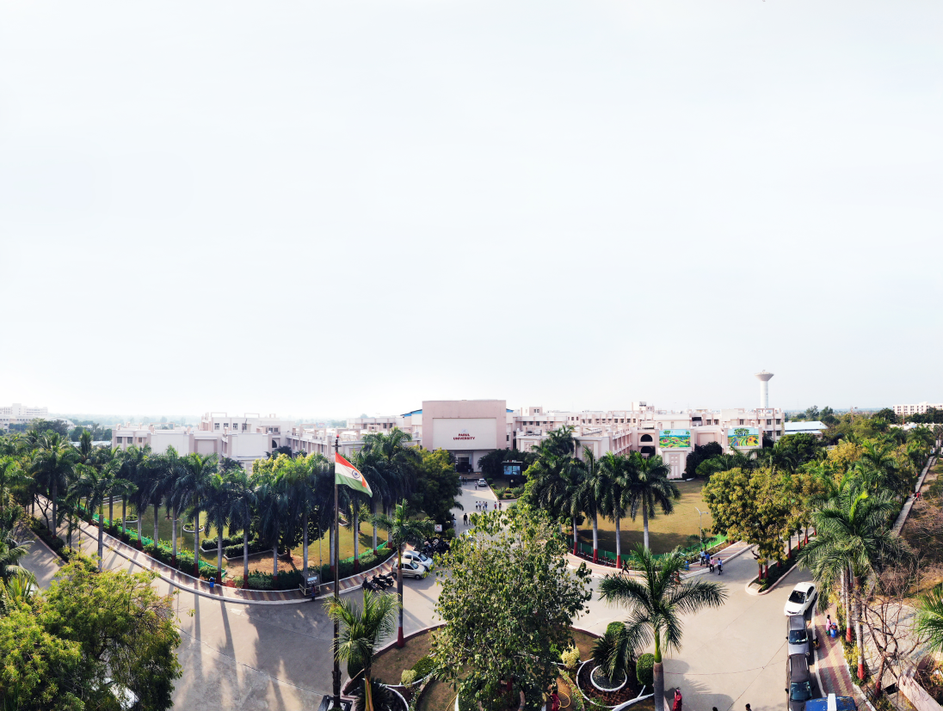


Object Oriented Programming with Java - 203105333
Prof. Tejal Patel, Assistant Professor
Computer Science and Engineering

Slide 2
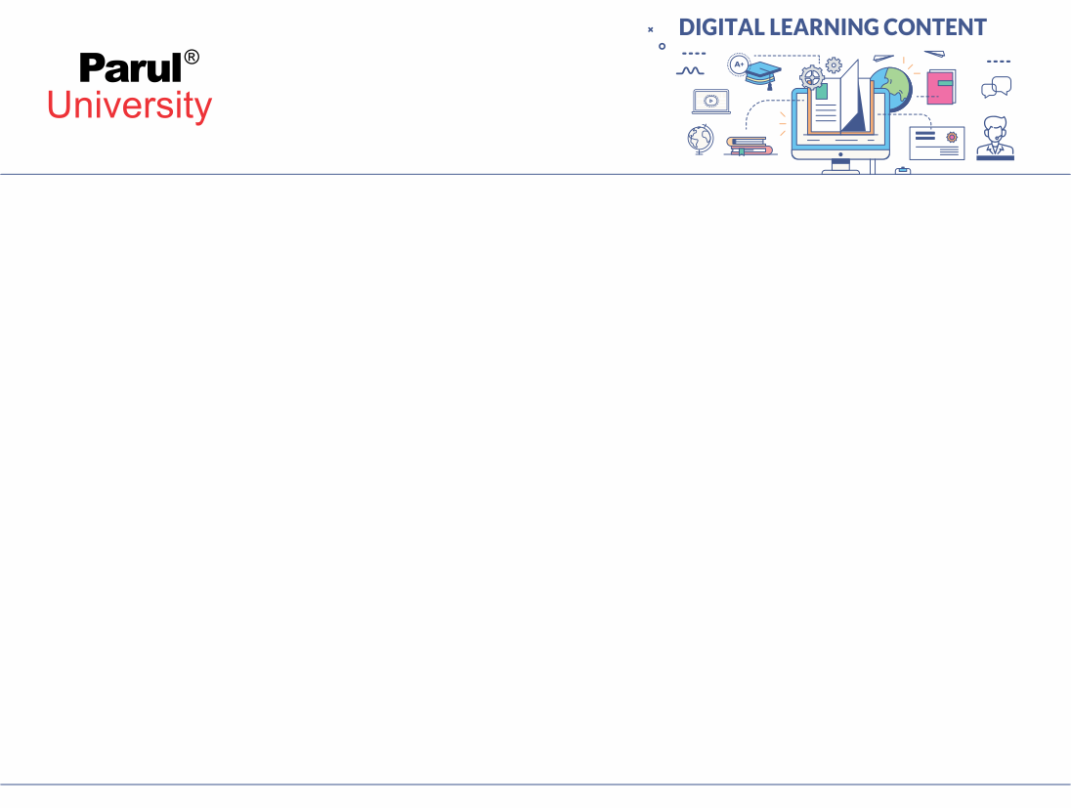

CHAPTER - 3
EVENT DRIVEN PROGRAMING

Slide 3
Topics
AWT Event Hierarchy, Graphics programming, Frame
Components, Working with shapes, Using color, fonts, and images
Basics of event handling, Event Handlers, Adapter classes
Actions, Mouse Events
Introduction to Swing, Model-View- Controller
Layout Management,
Swing Components - Design pattern ,Buttons

Slide 4
Abstract Window Toolkit(AWT)
The Abstract Window Toolkit (AWT) is Java’s original platform-independent windowing, graphics, and user-interface widget toolkit. The AWT classes are contained in the java.awt package.
Contains all of the classes for creating user interfaces and for painting graphics and images.
an API to develop GUI or window-based applications in java.

Slide 5
The Hierarchy of Java AWT classes
Object
Checkbox Group
Component
Container
Label
Button
Checkbox
Text Component
Panel
Window
TextArea
TextField
Applet
Frame
Dialog
FileDialog

Slide 6
AWT Classes
Component
A component is an object having a graphical representation that can be displayed on the screen and that can interact with the user.
Examples :
buttons, checkboxes, and scrollbars
The Component class is the abstract superclass of all user interface elements that are displayed on the screen.
A Component object remembers current text font, foreground and background color.

Slide 7
AWT Classes
Container
Container is a component that can contain other components like buttons, textfields, labels etc. in a specific layout.
It is a subclass of component class.
It keeps track of components that are added to another component.
In “Front to back” order components are listed within the container.
The classes that extend Container class are known as container such as Frame, Dialog and Panel.

Slide 8
AWT Classes
Window
The class Window is a top level window with no border and no menubar.
The default layout for a window is BorderLayout.
A window must have either a frame, dialog, or another window defined as its owner when it’s constructed.

Slide 9
AWT Classes
Panel
The class Panel is the simplest container class.
It provides space in which an application can attach any other component, including other panels.
The default layout manager for a panel is the FlowLayout layout manager
Frame
A Frame is a top-level window with a title and a border.
It uses BorderLayout as default layout manager.

Slide 10
AWT Classes
Dialog
A Dialog is a top-level window with a title and a border that is typically used to take some form of input from the user.
Canvas
Canvas component represents a rectangular area where application can draw something or can receive inputs created by user.
Drawing is not implemented on the canvas itself, but on the Graphics object provided by the canvas.
The Canvas is a section of a window to draw graphics or display images.
It is not a part of hierarchy of Java AWT.

Slide 11
Frame Class
Frame Window
A Frame provides the “main window” for the GUI application, which has title bar (containing an icon, a title, minimize, maximize/restore-down and close buttons), an optional menu bar, and the content display area.
When a frame object is created, by default it is invisible. You must call setVisible() method to make the frame appear on the screen.
Then, you must set the size of the frame using setSize() or setBound() method.

Slide 12
Commonly used methods of Frame class
Methods | Description
String getTitle() | Gets the title of the frame
void setBackground(Color bgColor) | Sets the background color of this window.
void setResizable (boolean resizable) | Sets whether this frame is resizable by the user.
void setShape (Shape shape) | Sets the shape of the window.
void setTitle (String title) | Sets the title for this frame to the specified string.
void setSize (Dimension d) | Resizes this component so that it has width d.width and height d.height.
void setVisible(boolean b) | Shows or hides this Window depending on the value of parameter b.

Slide 13
Creating a Frame
There are two ways to create a Frame:-
By Instantiating Frame class
By extending Frame class

Slide 14
Creating Frame Window by Instantiating Frame class
import java.awt.*;
public class AwtFrame {
public static void main(String[] args) {
Frame frm = new Frame(“Java AWT Frame”);
Label lbl = new Label(“Welcome”, Label.CENTER);
frm.add(lbl);
frm.setSize(400,400);
frm.setVisible(true);
}
}

Slide 15
Creating Frame window by extending Frame class
import java.awt.*;
import java.awt.event.WindowAdapter;
import java.awt.event.WindowEvent;
class DemoFrameExample extends Frame
{
DemoFrameExample()
{
super("Frame Example");
Label lb = new Label("Welcome to java world");
lb.setBounds(30,100,150,30);
add(lb);
setSize(300,300);
setLayout(null);
setVisible(true);
addWindowListener (new
WindowAdapter() {
public void windowClosing (WindowEvent
we) { System.exit(0); }
});
}
public static void main(String args[])
{
DemoFrameExample f = new
DemoFrameExample ();
} }

Slide 16
Creating an Frame Window in an Applet
The steps to be followed to create a child frame within an applet are as follows.
Create a subclass of Frame
Override any of the standard window methods, such as init(), start(), stop(), and paint().
Implement the windowClosing() method of the windowListener interface, calling setVisible(false) when the window is closed.
Once you have defined a Frame subclass, you can create an object of that class. But it will note be initially visible.
When created, the window is given a default height and width.
You can set the size of the window explicitly by calling the setSize() method.

Slide 17
Creating an Frame Window in an Applet
import java.awt.*;
import java.awt.Label;
import java.awt.event.*;
import java.applet.*;
public class DemoFrameApplet extends Applet {
Frame f;
public void init()
{
f = new Frame("A Frame Window");
f.setSize(300, 300);
Label lb = new Label("You are in a frame ");
f.add(lb);
f.setVisible(true);
}
public void start()
{ f.setVisible(true); }
public void stop()
{ f.setVisible(false); }
public void paint(Graphics g)
{
g.drawString("** You are in Applet **", 15, 30);
} }

Slide 18
Java Graphics Programming
The java.awt.Graphics class provides many methods for graphics programming.
A graphics context is encapsulated by the Graphics class and is obtained in two ways:
It is passed to an applet when one of its various methods, such as paint( ) or update( ) is called.
It is returned by the getGraphics( ) method of Component.

Slide 19
Graphics Methods
Methods | Description
abstract Graphics create() | Creates a new Graphics object that is a copy of this Graphics object
abstract void drawString(String str, int x, int y) | Draws the text given by the specified String
void drawRect(int x, int y, int width, int height) | draws a rectangle with the specified width and height
void draw3DRect(int x, int y, int width, int height, boolean raised) | Draws a 3-D highlighted outline of the specified rectangle.
abstract void drawRoundRect(int x, int y, int width, int height, int arcWidth, int arcHeight) | Draws an outlined round-cornered rectangle using this graphics context’s current Color

Slide 20
Graphics Methods
Methods | Description
abstract void fillRect(int x, int y, int width, int height) | fill rectangle with the default color and specified width and height
abstract void drawOval(int x, int y, int width, int height) | draw oval with the specified width and height.
abstract void fillOval(int x, int y, int width, int height) | fill oval with the default color and specified width and height
abstract void drawLine(int x1, int y1, int x2, int y2) | draw line between the points(x1, y1) and (x2, y2).
abstract boolean drawImage(Image img, int x, int y, ImageObserver observer) | draw the specified image

Slide 21
Graphics Methods
Methods | Description
abstract void drawArc(int x, int y, int width, int height, int startAngle, int arc Angle) | draw a circular or elliptical arc.
abstract void fillArc(int x, int y, int width, int height, int startAngle, int arcAngle) | fill a circular or elliptical arc.
abstract void drawPolygon(int[] xPoints, int[] yPoints, int nPoints) | Draws a closed polygon defined by arrays of x and y coordinates
abstract void fillPolygon(int[] xPoints, int[] yPoints, int nPoints) | Fills a closed polygon defined by arrays of x and y coordinates.
abstract void setFont(Font font) | set the graphics current font to the specified font.

Slide 22
Example: Graphics in Java
import java.applet.Applet;
import java.awt.*;
/* <applet code = ”GraphicsDemo.class” width=”300” height=”300”>
</applet> */
public class GraphicsDemo extends Applet {
public void paint(Graphics g) {
g.setColor(Color.red);
g.drawString(“Welcome”,50, 50);
g.drawLine(120,120,200,300);
g.drawRect(170,100,60,50);
g.fillRect(170,100,60,50);
g.drawOval(70,200,50,50);
g.setColor(Color.green);
g.fillOval(170,200,50,50);
// draw and fill arc
g.drawArc(90,150,70,70,0,75);
g.fillArc(270,150,70,70,0,75);
}
}

Slide 23
Components
Java AWT Component classes exist in java.awt package.
The Component class is a super class of all components such as buttons, checkboxes, scrollbars, etc.
Component class constructor:
Component() // constructs a new component

Slide 24
Properties of Java AWT Components
A Component object represents a graphical interactive area displayable on the screen that can be used by the user.
Any subclass of a Component class is known as a component. For example, button is a component.
Only components can be added to a container, like frame.

Slide 25
Commonly used methods of Component class
Methods | Description
setBackground(Color) | Sets the background color of this component.
setSize(int, int) | Resizes this component so that it has width width and height.
setVisible(boolean) | Shows or hides this component depending on the value of parameter b.
setFont(Font) | Sets the font of this component.
add(Component c) | Inserts a component on this component.
remove(Component c) | Removes the specified component from this component.
setBounds(int, int, int, int) | Moves and resizes this component

Slide 26
Working with shapes
Java supports 2-dimensional shapes, text and images using methods available in Graphics2D class.
The Graphics2D class extends the Graphics class to provide more sophisticated control over geometry, coordinate transformations, color management, and text layout.

Slide 27
Example - Working with shapes
import java.awt.*;
import java.applet.*;
/* <applet code=”ShapesDemo”
width=350 height=300>
</applet> */
public class ShapesDemo extends
Applet {
public void init() { }
public void paint(Graphics g) {
Graphics2D g2 = (Graphics2D) g;
g2.setColor(Color.blue);
g2.drawRect(75,75,300,200);
Font exFont = new
Font(“TimesRoman”,Font.PLAIN,40);
g2.setFont(exFont);
g2.setColor(Color.black);
g2.drawString(“Graphics2D
Example”,120.0f,100.0f);
g2.setColor(Color.green);
g2.drawLine(100,100,300,200);
g2.drawOval(150,150,100,200);
g2.fillOval(150,150,100,200);
} }

Slide 28
Colors in Java
To support different colors Java package comes with the Color class.
The Color class states colors in the default sRGB color space or colors in arbitrary color spaces identified by a ColorSpace.
Color class static color variables available are:
Color.black | Color.lightGray | Color.blue
Color.magenta | Color.cyan | Color.orange
Color.darkGray | Color.red | Color.green
Color.white | Color.yellow | Color.gray

Slide 29
Colors in Java
Color class constructor:
Color(float r, float g, float b) -
create color with specified red, green, and blue values in the range (0.0 - 1.0)
Color(int r, int g, int b) -
create color with the specified red, green, and blue values in the range (0 - 255).

Slide 30
Example - Colors in Java
import java.awt.*;
import java.applet.*;
/*
<applet code=”ColorDemo” width=350 height=300>
</applet>
*/
public class ColorDemo extends Applet {
public void init() {
setBackground(Color.CYAN);
}
public void paint(Graphics g) {
g.setColor(Color.red);
g.drawRect(50, 100, 150, 100);
Color clr = new Color(200, 100, 150);
g.setColor(clr);
g.fillRect(220,100, 150, 100);
} }

Slide 31
Font in Java
The Font class states fonts, which are used to render text in a visible way.
Font class constructor
Font(Font font) //Creates a new Font from the specified font.
Font(String name, int style, int size) //Creates a new Font from the specified name, style and point size.

Slide 32
Commonly used methods supported by the Font class
Method | Description
String getFamily() | Returns the family name of this Font.
int getStyle() | Returns the style of this Font
boolean isBold() | Indicates whether or not this Font object’s style is BOLD
boolean isItalic() | Indicates whether or not this Font object’s style is ITALIC
boolean isPlain() | Indicates whether or not this Font object’s style is PLAIN

Slide 33
Font in Java
Font variables available in Font class are:
Font.BOLD | Font.SANS_SERIF
Font.ITALIC | Font. CENTER_BASELINE
Font. PLAIN | Font. DIALOG
Font. MONOSPACED | Font. SERIF
Font. TRUETYPE_FONT | Font. TYPE1_FONT

Slide 34
Example - Font in Java
import java.applet.Applet;
import java.awt.*;
import java.awt.event.*;
/* <applet code=”FontDemo.class”
WIDTH=300 HEIGHT=200>
</applet> */
public class FontDemo extends
java.applet.Applet {
Font f;
String m;
public void init()
{
f=new Font(“Arial”,Font.ITALIC,20);
m=”Welcome to Java”;
setFont(f);
}
public void paint(Graphics g)
{
Color c=new Color(100,100,255);
g.setColor(c);
g.drawString(m,4,20);
Font italicFont = new Font(“Serif”,
Font.ITALIC, 24);
g.setFont(italicFont);
g.drawString(“Font in ITALIC”, 50, 120);
} }

Slide 35
Images in Java
Image control is superclass for all image classes representing graphical images.
The java.applet.Applet class provides following methods to access image.
getImage() method that returns the object of Image. Its syntax is as follows.
public Image getImage(URL u, String image){ }
getDocumentBase() method returns the URL of the document in which applet is embedded.
public URL getDocumentBase(){}
URL getCodeBase() method returns the base URL.
public URL getCodeBase()

Slide 36
Example - Image in Java
import java.applet.Applet;
import java.awt.*;
import java.awt.event.*;
import java.net.URL;
/* <applet code =”ImageDemo.class” width=300 height=200> </applet> */
public class ImageDemo extends java.applet.Applet
{
Image img;
public void init() { }
public void paint(Graphics g)
{
URL url1 = getCodeBase();
img = getImage(url1,”java.jpg”);
g.drawImage(img, 60, 120, this);
} }

Slide 37
Event Handling
Any change in the state of any object is called event.
For example, Pressing a button, entering a character in Textbox, Clicking or dragging a mouse, etc.
The three main elements in event handling are:
Event
Events Source
Listeners

Slide 38
Elements in Event handling
Event:
An event is a change in state of an object. For example, mouseClicked, mousePressed.
Events Source:
Event source is an object that generates an event. Example: a button, frame, textfield.
Listeners:
A listener is an object that listens to the event. A listener gets notified when an event occurs. When listener receives an event, it process it and then return. For example, MouseListener handles all MouseEvent.

Slide 39
Event Classes and Listener interfaces
Event Class | Generated When | Listener Interfaces
ActionEvent | button is pressed, menu-item is selected, list-item is double clicked | Action Listener
MouseEvent | mouse is dragged, moved, clicked, pressed or released and also when it enters or exit a component | Mouse Listener and Mouse Motion Listener
MouseWheelEvent | mouse wheel is moved | Mouse Wheel Listener
KeyEvent | input is received from keyboard | Key Listener
ItemEvent | check-box or list item is clicked | Item Listener

Slide 40
Example - Event in Java
import java.awt.event.*;
import java.applet.*;
import java.awt.*;
/* <applet code= ”Test.class” width=400 height=300>
</applet> */
public class Test extends Applet implements KeyListener {
String msg= “ “;
public void init()
{ addKeyListener(this); }
public void keyPressed(KeyEvent k)
{ showStatus(“KeyPressed”); }
public void keyReleased(KeyEvent k)
{ showStatus(“KeyRealesed”); }
public void keyTyped(KeyEvent k)
{
msg = msg+k.getKeyChar();
repaint();
}
public void paint(Graphics g)
{ g.drawString(msg, 20, 40); }
}

Slide 41
Adapter Classes
An adapter class provides the default implementation of all methods in an event listener interfaces.
Adapter classes are very useful when you want to process only few of the events that are handled by a particular event listener interface.
The adapter classes are found in java.awt.event, java.awt.dnd and javax.swing.event packages.

Slide 42
Adapter classes with their corresponding listener interfaces
Adapter Class | Listener Interface
Mouse Adapter | Mouse Listener
Mouse Motion Adapter | Mouse Motion Listener
Key Adapter | Key Listener
Window Adapter | Window Listener
Focus Adapter | Focus Listener

Slide 43
Example – Adapter class in Java
import java.awt.*;
import java.awt.event.*;
public class AdapterExample {
Frame f;
AdapterExample() {
f=new Frame(“Window Adapter”);
f.addWindowListener(new WindowAdapter() {
public void windowClosing(WindowEvent e)
{ f.dispose();}
});
f.setSize(400,400);
f.setLayout(null);
f.setVisible(true);
}
public static void main(String[] args) {
new AdapterExample();
} }

Slide 44
Java Actions
The Java Action interface and AbstractAction class are terrific ways of encapsulating behaviors (logic), especially when an action can be triggered from more than one place in your Java/Swing application.
An Action can be used to separate functionality and state from a component.
For example, if you have two or more components that perform the same function, consider using an Action object to implement the function.

Slide 45
Java Actions
An Action object is an action listener that provides not only action-event handling, but also centralized handling of the state of action-event-firing components such as tool bar buttons, menu items, common buttons, and text fields.
The most common way an action event can be triggered from multiple places in a Java/Swing application is through the Java menubar (JMenuBar) and toolbar (JToolBar).

Slide 46
Example – Java Actions
JButton button = new JButton(“ << Java Action >>”);
// Add action listener to button
button.addActionListener(new ActionListener()
{
public void actionPerformed(ActionEvent e)
{
System.out.println(“You clicked the button”);
}
});

Slide 47
MouseEvent
An event which indicates that a mouse action occurred in a component.
A mouse action is considered to occur in a particular component if and only if the mouse cursor is over the part of the component’s bounds when the action happens.
For lightweight components, such as Swing’s components, mouse events are only dispatched to the component if the mouse event type has been enabled on the component.

Slide 48
MouseEvent
A mouse event type is enabled by adding the appropriate mouse-based EventListener to the component (Mouse Listener or Mouse Motion Listener), or by invoking Component.enableEvents (long) with the appropriate mask parameter
(AWTEvent.MOUSE_EVENT_MASK
or
AWTEvent.MOUSE_MOTION_EVENT_ MASK).

Slide 49
Hierarchy of MouseEvent class
java.lang.Object
java.awt.AWTEvent
java.awt.event.ComponentEvent
java.awt.event.InputEvent
java.util.EventObject
java.awt.event.MouseEvent

Slide 50
List of MouseEvent
mousePressed : mouse button is pressed
mouseReleased : a mouse button is released
mouseClicked : a mouse button is clicked (pressed and released)
mouseEntered : the mouse cursor enters the unobscured part of component’s geometry
mouseExited : the mouse cursor exits the unobscured part of component’s geometry

Slide 51
List of Mouse Motion Event
mouseMoved : the mouse is moved
mouseDragged : the mouse is dragged

Slide 52
Example: MouseEvent
import java.awt.*;
import java.awt.event.*;
pubic class MouseListenerExample extends Frame implements MouseListener {
Label l;
MouseListenerExample() {
addMouseListener(this);
l=new Label();
l.setBounds(20,50,100,20);
add(l);
setSize(300,300);
setLayout(null);
setVisible(true);
}
public void mouseClicked(MouseEvent e) {
l.setText(“Mouse Clicked”);
} ……… //add all implemented methods of MouseEvent
}

Slide 53
Java Swing
Swing was developed to provide a more sophisticated set of GUI components than the earlier Abstract Window Toolkit (AWT).
Java Swing is a part of Java Foundation Classes (JFC) that is used to create window based applications. It is built on the top of AWT (Abstract Windowing Toolkit) API and entirely written in java.
Swing provides programmer the facility to change the look and feel of components being displayed on any system. This is called ‘plaf’ (pluggable look and feel).

Slide 54
Java Swing
Unlike AWT, Java Swing provides platform-independent and lightweight components.
There are 3 types of Look & Feel available in Swing :
Metal Look & Feel
Motif Look & Feel
Windows Look & Feel
By default, Swing programmer use ‘metal look and feel’.
The javax.swing package provides classes for java swing API such as JButton, JTextField, JTextArea, JRadioButton, JCheckbox, JMenu, JColorChooser etc.

Slide 55
Swing Features
Light Weight - Swing component are independent of native Operating System’s API as Swing API controls are rendered mostly using pure JAVA code instead of underlying operating system calls.
Rich controls - Swing provides a rich set of advanced controls like Tree, TabbedPane, slider, colourpicker, table controls
Highly Customizable - Swing controls can be customized in very easy way as visual appearance is independent of internal representation.
Pluggable look-and-feel - SWING based GUI Application look and feel can be changed at run time based on available values.

Slide 56
Differences between Java AWT and Swing
Java AWT | Java Swing
AWT stands for Abstract windows toolkit. | Swing is also called as JFC.
AWT components are platform-dependent. | Java swing components are platform-independent.
AWT components are heavyweight. | Swing components are lightweight.
AWT doesn't support pluggable look and feel. | Swing supports pluggable look and feel.
AWT components require java.awt package. | Swing components require javax.swing package.
AWT provides less components than Swing. | Swing provides more powerful components such as tables, lists, scrollpanes, colorchooser, tabbedpane etc.

Slide 57
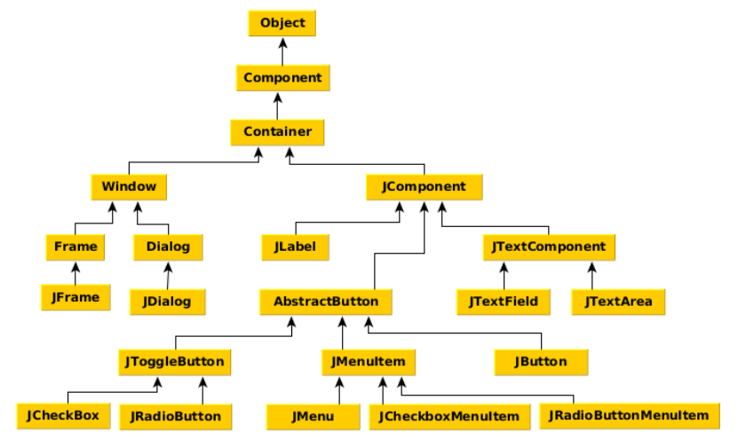
Hierarchy of Java Swing classes

Slide 58
Swing Components
Swing components are basic building blocks of an application.
Swing has a wide range of various components, including buttons, check boxes, sliders, and list boxes.
They all are derived from JComponent class. All these components are lightweight components.
This class provides some common functionality like pluggable look and feel, support for accessibility, drag and drop, layout, etc.

Slide 59
Swing Components
Container: An abstract class that extends Component. Containers can hold multiple components.
Containers are of two types:
Top level Containers
Lightweight Containers

Slide 60
Swing Components
Container: An abstract class that extends Component. Containers can hold multiple components.
Containers are of two types:
Top level Containers
Lightweight Containers

Slide 61
Containers
Top Level Containers:
It inherits Component and Container of AWT.
It cannot be contained within other containers.
Heavyweight.
Example: JFrame, JDialog, Japplet
Lightweight Containers:
It inherits JComponent class.
It is a general purpose container.
It can be used to organize related components together.
Example: JPanel

Slide 62
JButton
JButton extends Component , displays a string, and delivers an ActionEvent for each mouse click.
Normally buttons are displayed with a border.
In addition to text, JButtons can also display icons.
JButton class has three constructors:
JButton(Icon ic)
JButton(String str)
JButton(String str, Icon ic)

Slide 63
JLabels
JLabels are components that you can fill with text.
When creating a label you can specify the initial value and the alignment you wish to use within the label.
You can use getText() and setText() to get and change the value of the label.
The JLabel Contains 4 constructors:
JLabel()
JLabel(String s)
JLabel(Icon i)
JLabel(String s, Icon i, int horizontalAlignment)

Slide 64
JTextField
JTextField is used for taking input of single line of text.
It is widely used text Component.
It has three constructor:
JTextField(int cols)
JTextField(String str, int cols)
JTextField(String str)

Slide 65
Commonly used Methods of Component class
The methods of Component class are widely used in Java Swing :
Method | Description
public void add(Component c) | add a component on another component.
public void setSize (int width, int height) | sets size of the component.
public void setLayout (LayoutManager m) | sets the layout manager for the component.
public void setVisible(boolean b) | sets the visibility of the component. It is by default false.

Slide 66
Java Swing Examples
There are two ways to create a frame using swing:
By creating the object of Frame class (association)
By extending Frame class (inheritance)

Slide 67
Simple Java Swing Example
import javax.swing.*;
public class FirstSwingExample {
public static void main(String[] args) {
JFrame f=new JFrame(); //creating instance of JFrame
JButton b=new JButton(“click”); //creating instance of JButton
b.setBounds(130,100,100, 40); //x axis, y axis, width, height
f.add(b); //adding button in JFrame
f.setSize(400,500); //400 width and 500 height
f.setLayout(null); //using no layout managers
f.setVisible(true); //making the frame visible
} }

Slide 68
Example : Swing by Association inside constructor
import javax.swing.*;
public class Simple {
JFrame f;
Simple() {
f=new JFrame();
JButton b=new Jbutton ("click");
b.setBounds(130,100,100, 40);
f.add(b);
f.setSize(400,500);
f.setLayout(null);
f.setVisible(true);
}
public static void main (String[] args)
{
new Simple();
} }

Slide 69
Example : Swing by inheritance
import javax.swing.*;
public class Simple2 extends JFrame {
JFrame f;
Simple2() {
JButton b=new Jbutton ("click");
b.setBounds(130,100,100, 40);
add(b);
setSize(400,500);
setLayout(null);
setVisible(true);
}
public static void main (String[] args)
{
new Simple2();
}
}

Slide 70
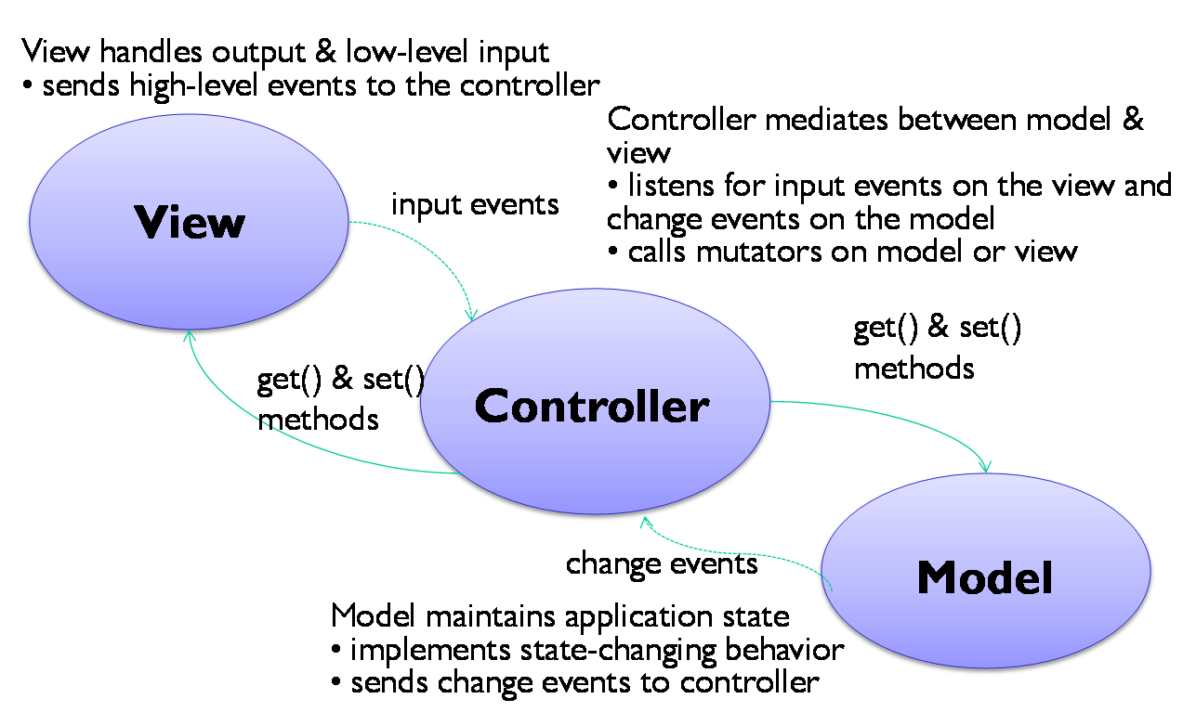
Model-View-Controller
Swing uses the model-view-controller architecture (MVC) as the fundamental design behind each of its components.

Slide 71
Layout manager
The LayoutManagers are used to arrange components in a particular manner.
LayoutManager is an interface that is implemented by all the classes of layout managers.
There are following classes that represents the layout managers:
java.awt.BorderLayout
java.awt.FlowLayout
java.awt.GridLayout
java.awt.CardLayout
java.awt.GridBagLayout
javax.swing.BoxLayout

Slide 72
Java FlowLayout
Fields of FlowLayout class
public static final int LEFT
public static final int RIGHT
public static final int CENTER
public static final int LEADING
public static final int TRAILING
Constructors of FlowLayout class
FlowLayout(): creates a flow layout with centered alignment and a default 5 unit horizontal and vertical gap.
FlowLayout(int align): creates a flow layout with the given alignment and a default 5 unit horizontal and vertical gap.
FlowLayout(int align, int hgap, int vgap): creates a flow layout with the given alignment and the given horizontal and vertical gap

Slide 73
Example : FlowLayout
import java.awt.*;
import javax.swing.*;
public class MyFlowLayout {
JFrame f;
MyFlowLayout()
{
f=new JFrame();
f.setLayout(new FlowLayout(FlowLayout.RIGHT));
JButton b1=new JButton("1");
JButton b2=new JButton("2");
JButton b3=new JButton("3");
JButton b4=new JButton("4");
JButton b5=new JButton("5");
f.add(b1);f.add(b2);f.add(b3);
f.add(b4);f.add(b5);
f.setSize(300,300);
f.setVisible(true);
}
public static void main(String[] args)
{
new MyFlowLayout();
} }

Slide 74
Java BorderLayout
Fields of BorderLayout class
public static final int NORTH
public static final int SOUTH
public static final int EAST
public static final int WEST
public static final int CENTER
Constructors of BorderLayout class
BorderLayout(): creates a border layout but with no gaps between the components.
BorderLayout(int hgap, int vgap): creates a border layout with the given horizontal and vertical gaps between the components

Slide 75
Example : BorderLayout
import java.awt.*;
import javax.swing.*;
public class BorderDemo {
JFrame f;
BorderDemo()
{
f=new JFrame();
f.setLayout(new BorderLayout());
JButton b1=new JButton("NORTH");
JButton b2=new JButton("SOUTH");
JButton b3=new JButton("EAST");
JButton b4=new JButton("WEST");
JButton b5=new JButton("CENTER");
f.add(b1,BorderLayout.NORTH);
f.add(b2,BorderLayout.SOUTH);
f.add(b3,BorderLayout.EAST);
f.add(b4,BorderLayout.WEST);
f.add(b5,BorderLayout.CENTER);
f.setSize(300,300);
f.setVisible(true);
}
public static void main(String[] args)
{
new BorderDemo();
} }

Slide 76
Java BoxLayout
Fields of BoxLayout class
public static final int X_AXIS
public static final int Y_AXIS
Constructors of BoxLayout class
BoxLayout(Container c, int axis):
creates a box layout that arranges the components with the given axis

Slide 77
Example : BoxLayout
import java.awt.*;
import javax.swing.*;
public class BoxDemo extends Frame {
Button buttons[];
public BoxDemo () {
buttons = new Button [5];
for (int i = 0;i<5;i++) {
buttons[i] = new Button ("Button " + (i + 1));
add (buttons[i]);
}
setLayout (new BoxLayout (this, BoxLayout.Y_AXIS));
setSize(400,400);
setVisible(true);
}
public static void main(String args[])
{
BoxDemo b=new BoxDemo();
} }

Slide 78
Java GridLayout
The GridLayout is used to arrange the components in rectangular grid.
One component is displayed in each rectangle.
Constructors of GridLayout class:
GridLayout(): creates a grid layout with one column per component in a row.
GridLayout(int rows, int columns): creates a grid layout with the given rows and columns but no gaps between the components.
GridLayout(int rows, int columns, int hgap, int vgap): creates a grid layout with the given rows and columns alongwith given horizontal and vertical gaps.

Slide 79
Example : GridLayout
import java.awt.*;
import javax.swing.*;
public class GridDemo {
JFrame f;
GridDemo() {
f=new JFrame();
JButton b1=new JButton("1");
JButton b2=new JButton("2");
JButton b3=new JButton("3");
JButton b4=new JButton("4");
f.add(b1); f.add(b2); f.add(b3); f.add(b4);
f.setLayout (new GridLayout(2,2));
//setting grid layout of 2 rows and 2 columns
f.setSize(300,300);
f.setVisible(true);
}
public static void main(String[] args)
{
new GridDemo();
} }

Slide 80


www.paruluniversity.ac.in

